Slide 1
Skyfall-WebGPU: Milestone 2
Group 13

Slide 2
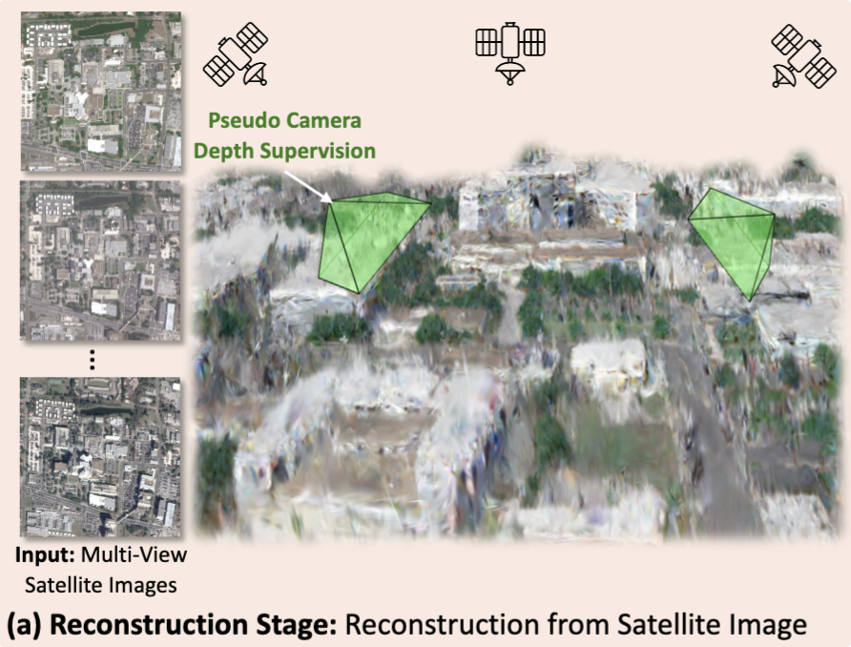
Project Recap
Recap Milestone 1:
Added shared GPU buffers for live updates
Integrated preprocess + sort for training compatibility
Implemented Google Maps–style camera
New default camera setup (top-down view)
Source: Skyfall-GS
Notes:
Hey guys, we’re Skyfall-WebGPU. Just a quick reminder, our goal is to bring the Skyfall Gaussian Splatting pipeline into the browser using WebGPU. The idea is to take multi-view satellite images and pointclouds, turn them into a 3D scene made of Gaussian splats, and render that in real time on the web. In Milestone 1, we mostly focused on laying the foundation. We got the Gaussian renderer working inside our pipeline, made it dynamic on the GPU instead of static, cleaned up the preprocessing and sorting so it runs smoothly each frame, and added map-style camera controls so it’s easy to move around the scene. All of that is now going to be the visualization backbone for what we’re building in Milestone 2.

Slide 3
3DGS in WebGPU

Slide 4
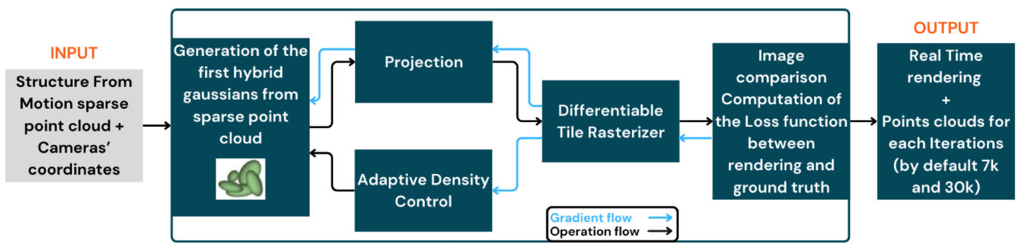
Implementation

Slide 5
Implementation
New WebGPU compute shader for splat reconstruction from Pointcloud + Images (3DGS like, with no autograd)
  Including Prune + Densify shaders running at pre-defined intervals
Split viewer camera and training camera
Load folder instead of separate files

Slide 6
Quick Demo

Slide 7
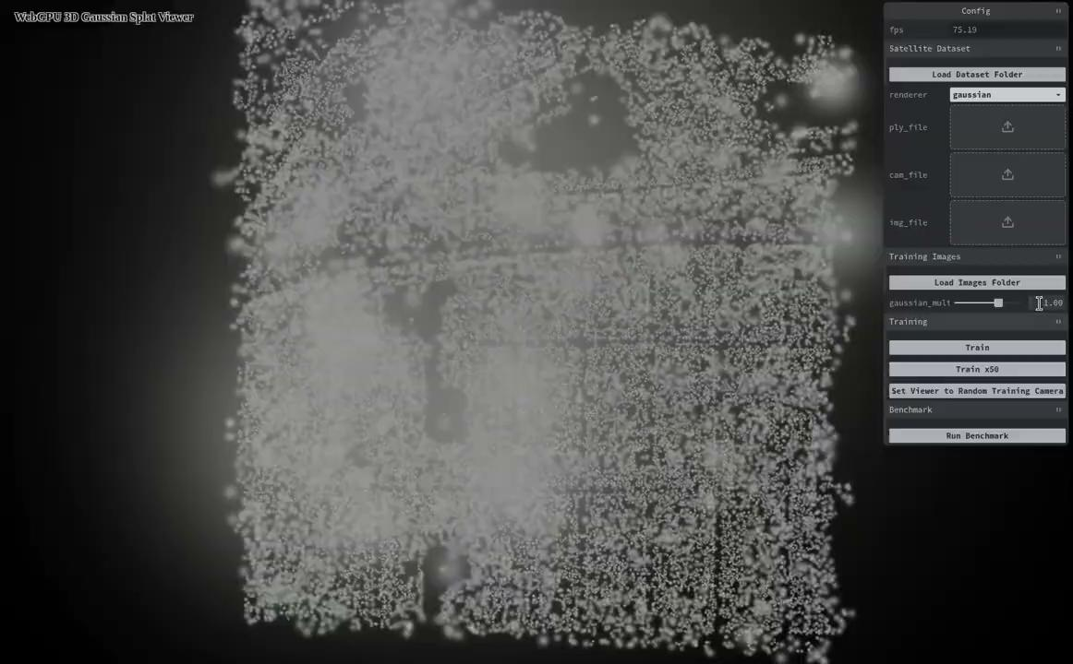

Slide 8
Challenges & Next Steps
Cannot reconstruct self-consistent set of camera parameters from training datasets
  Datasets by the authors are missing regularization parameters
  Reached out to the authors, waiting on response
Hand derived gradients are fragile
  Requires parameter fine-tuning
  Splats don’t want to grow
  Higher fidelity color matching hard to achieve
Notes:
Memorized:
The first challenge concerns the data provided with the original paper. Based on our interpretation, it appears that some of the camera regularization parameters are missing. When we apply the provided camera transformations, the results are not visually correct. We have reached out to the authors for clarification and are currently waiting for their response.
The second issue is related to gradient computation. Unlike the authors, who utilized Python and libraries like PyTorch for deep learning style gradient computation, our implementation in WebGPU lacks such a autograd library. We currently have a hard-coded gradient and backward propagation implemented. This approach needs significant improvement for both better performance and generalization.

